Slide 1
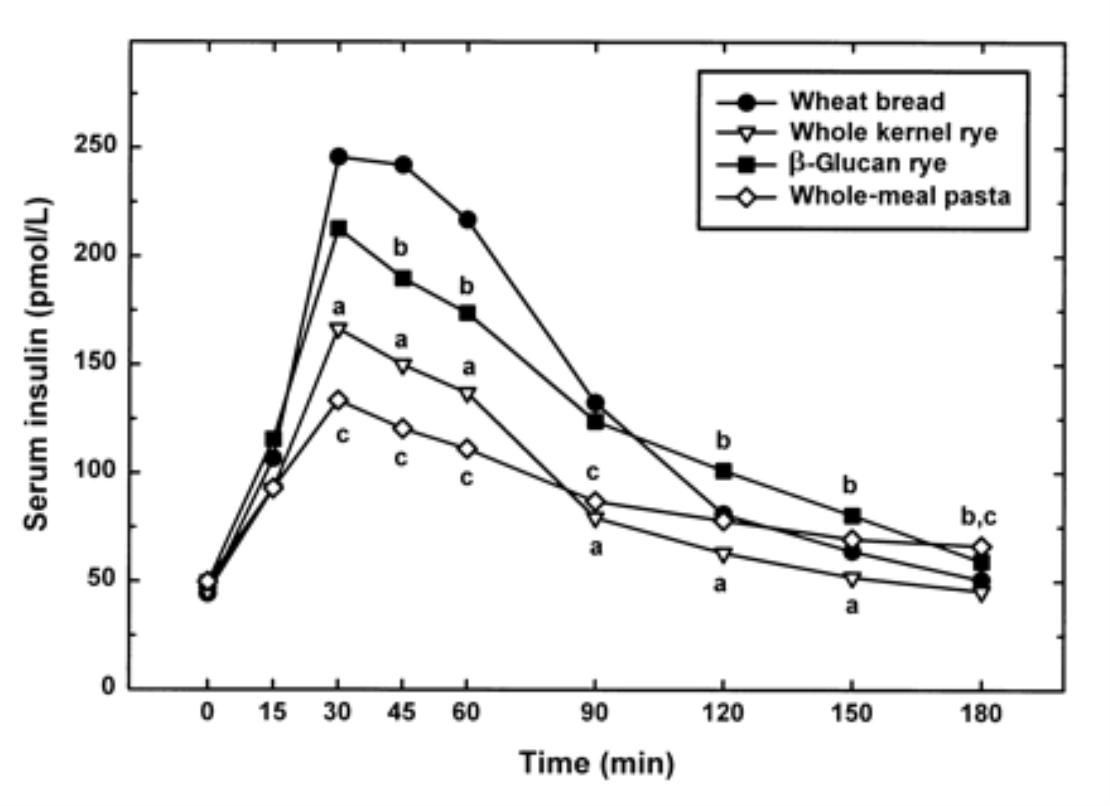
From: Postprandial glucose, insulin, and incretin responses to grain products in healthy subjects
Am J Clin Nutr. 2002;75(2):254-262. doi:10.1093/ajcn/75.2.254
Am J Clin Nutr | © 2002 American Society for Clinical Nutrition
Notes:
FIGURE 3. Mean fasting and postprandial insulin responses to rye and wheat products over 180 min (n = 20). Postprandial insulin responses to whole-kernel rye bread (a), β-glucan rye bread (b), and pasta (c) were significantly different from those to white wheat bread, P < 0.05. The pooled SEM was 40.5 for the whole-kernel rye bread, 56.3 for the β-glucan rye bread, 36.3 for the pasta, and 73.8 for the white wheat bread.

